Slide 1

FAIR Digital Objects@ Helmholtz Metadata Collaboration Platform Thomas Jejkal, Rainer Stotzka Espoo, 10/22/19
CC BY-SA 4.0

Slide 2
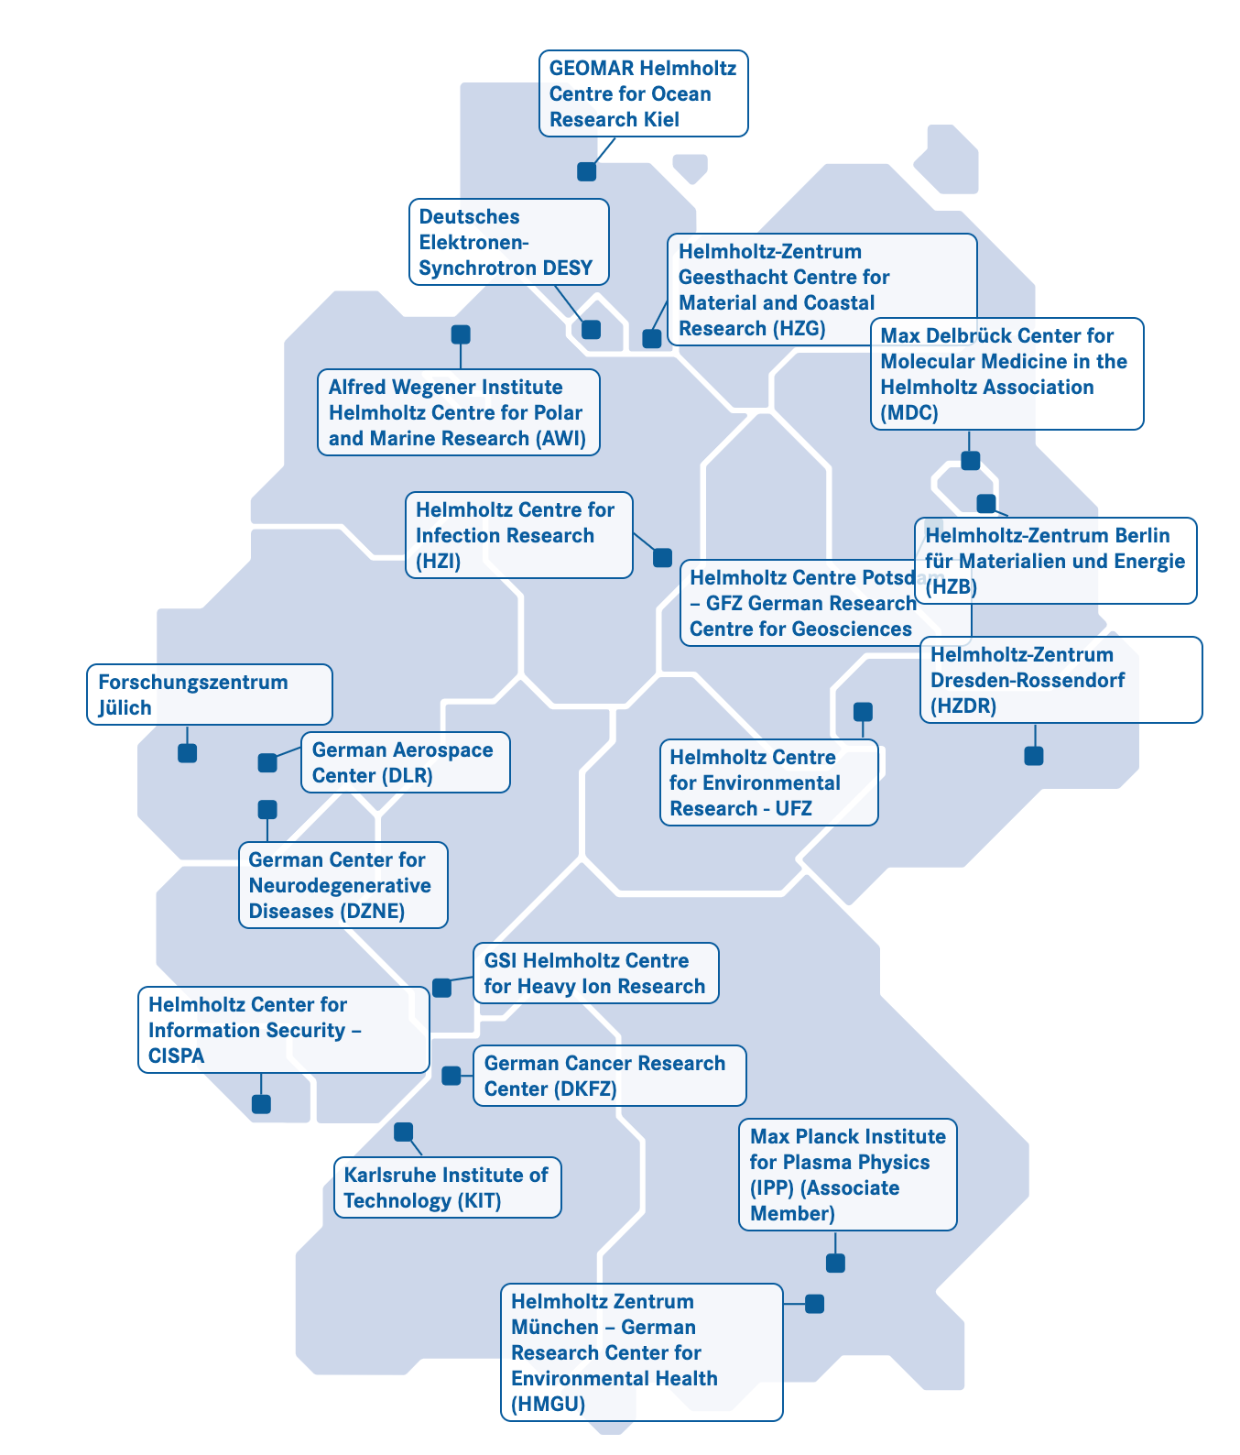
Helmholtz “Information & Data Science”
Helmholtz Association of 19 German Research Centers: Energy, Earth & Environment, Health, Aeronautics & Space & Transport, Matter, Key Technologies
Incubator „Information & Data Science“
Aims of the Incubator:
Networking of the relevant actors in Helmholtz
Identification of the most interesting topics and pilots
Developing an education platform Data Science Academy
Developing further platforms for Metadata, Imaging, Machine Learning, AI

Slide 3
Helmholtz Metadata Collaboration Platform – Objectives
Establish in scientific disciplines and research infrastructures:
Qualitative description of research data by metadata
Cross-community and international networking
Providing infrastructure components
Process research data following FAIR principles
Promote a new research culture

Slide 4
HMC Structure
NFDI
Hub
Matter
EOSC
Central office for coordination, training, recommendation
Development and provisioning of technical services and tools
Six metadata hubs gathering and harmonizing domain-specific solutions, implementations and adoptions
Close cooperation with global efforts, e.g. RDA, EOSC, GO FAIR etc.
Hub
Energy
Hub
Health
RDA
Processes
Projects
HMC
Office
Facilitate FAIR
Training
Info Portal
Tools
Hub
Information
Hub
AST
Hub
Earth &
Env.

Slide 5
Technical Overview
Components and Processes –
Technical Realization of FAIR
Tools and Components for realizing FAIR processes
Findable
(Metadata,
PID Management)
Accessible
Interoperable
(Ontologies,
Semantic Web)
Re-usable
(Provenance)
WP 2.2
WP 2.2.1
WP 2.2.2
WP 2.2.3
WP 2.2.4
Tools
HMC Overarching
Technical Services
Tools for Managing Services, Curation of Contents
WP 2.1.2
Editors
Quality Control
Recommender
Mapper
Provenance
…
Interfaces
EOSC, NFDI
Protocols
APIs
WP 2.1.2
Registries and Catalogs:
MD Standards
MD Schema incl. Provenance
Datatypes
Collections
Licenses
Repositories
PID / DOI
Graph DB
PROV
…
Policies
Mappings
Vocabularies
…
WP 2.1
WP 2.1.1
(Meta)-Data Store
Vocabulary Store
AAI
…
IT Services
Local and federated computing centers, HIFIS, HDF, …

Slide 6
Focus for the next years
FAIR Digital Objects, but technologically invisible
Step-by-step: demonstration of benefits
Ecosystem of technical components adopted from RDA, EOSC, research fields, …
Services on production level, deployed centrally as well as locally
As open as possible including licenses
We need:
Experts and knowledge: e.g. how to build a fault-tolerant network of registries?
Network of cross-linked activities

